Slide 1
Data Quality in the Collection and Reporting of American Indian/Alaska Native Education Data
By
Dawn M. Mackety, Amber Ebarb, & Heather Zenone
NCES STATS-DC 2012 Data Conference
July 12, 2012
Washington, DC
Notes:
Proposal submission (4/23/12)
Concurrent Session Presentation
Format: Panel
Presentation Title:
Data Quality in the Collection & Reporting of American Indian/Alaska Native Education Data
Presenters/Co-presenters (name and e-mail address):
Dawn Mackety, dmackety@niea.org<mailto:dmackety@niea.org>
Malia Villegas, mvillegas@ncai.org<mailto:mvillegas@ncai.org>
Presentation abstract:
Executive Order 13592 seeks to improve Native education by requiring the development of "sufficient data resources to inform progress on Federal performance indicators, in close collaboration with the…National Center for Educational Statistics". Panelists will highlight data quality issues and opportunities in relation to AI/AN and tribal education. Discussion will include the impact of ED's implementation of OMB Racial and Ethnicity Classifications on availability of AI/AN data and the impact of the recent decision to disinclude BIE schools from the SASS. Panelists will discuss alternative data collection methodologies and suggest alternative data reporting approaches to improve NCES policy.
Session Topics: Data Quality, Data Collection

Slide 2
Rationale
Tribal sovereignty requires access to quality, meaningful data
Federal agencies are responsible to collect and report accurate AI/AN data
Monitor fulfillment of the Federal Trust Responsibility to AI/AN people
Monitor AI/AN student performance
Notes:
“Robust data on the size and characteristics of the AI/AN [American Indian and Alaska Native] population in every community is essential to charting a course for the progress of the Native people in that community” (DeWeaver, 2010, p. ii).
Data sovereignty in terms of the “cloud” and digital data
Knowing who we are and how that informs community planning is about our visibility in the US (representation), the appropriateness of current measures (indicators), and our status (comparison level).

Slide 3
Executive Order 13592 Improving AI/AN Educational Opportunities and Strengthening Tribal Colleges and Universities
Improve Native education by requiring…
“developing sufficient data resources to inform progress on Federal performance indicators, in close collaboration with the…National Center for Educational Statistics” (Section 3b-1-viii)
Notes:
Website for EO:
http://www.whitehouse.gov/the-press-office/2011/12/02/executive-order-improving-american-indian-and-alaska-native-educational-

Slide 4
Overview
Background and Status
Data Quality Challenges
Tribal Use of Data & Indicators
Recommendations
Notes:
Background & Status (from my PPT)
Data Quality & Challenges (includes the OMB/ED Implementation issue that she currently has related to Federal Role)
Priority Data Needs
Alternative & Culturally-Based Approaches
Recommendations

Slide 5
Background & Status
Who is an AI/AN student?
Where are AI/AN students served?
Who provides educational services to AI/AN students?
Notes:
Where are our AI/AN students?
90% in traditional public schools
On or off reservation?
In tribal, charter, or public schools?
In rural or urban contexts?
In alternative education programs?
Who provides ed services:
Headstart, JOM, BIE, States, TCUs
Who is involved in advocating on behalf of AI/AN education:
NIEA, NCAI, Tribal Ed Departments, AIHEC, Regional orgs (WestEd; Education Northwest), White House Initiative
Who collects data on AI/AN education?
Census, ED, CCD, NCES, NAEP, NIES, DOJ, BIE

Slide 6
Federal Sources for AI/AN Education Data
U.S. Census
American Community Survey
Current Population Survey(?)
U.S. Bureau of Labor Statistics
Civil Rights Data Collection
National Center for Education Statistics (Common Core of Data, NAEP, NIES)
Notes:
Discuss issues when collecting & reporting data from multiple sources.
Data aren’t comparable.
Need for communication across datasets
Need easy access to datasets (some more difficult to use)

Slide 7
Data Quality Challenges
Disaggregating to tribal level
Compatibility across databases
Sampling & Inclusion
Undercounting AI/AN students
Notes:
(oversampling so data can be reported, BIE excluded from SASS)
American Indians and Alaska Natives living on reservations were undercounted by 4.9 percent in the 2010 Census.
According to The Condition of Education 2011 report, using data from the Current Population Survey, the number of prekindergarten through 12th grade AI/AN students in the nation’s public schools dropped by half from 622,000 (1.2%) in October 2002 to 314,000 (0.6%) in October 2003, after the “Two or more races” category was introduced to the survey.

Slide 8
Agency Implementation of OMB Standards for Racial & Ethic Data Reporting
Aggregate categories for reporting
Hispanic/Latino of any race
Non-Hispanic/Latino
American Indian or Alaska Native
Asian
Black or African American
Native Hawaiian or Other Pacific Islander
White
Two or more races
Notes:
Final Guidance on Maintaining, Collecting and Reporting Racial and Ethnic Data (U.S. Department of Education, 2007)
“When aggregating local data for federal reporting…the seven aggregate categories for reporting to USED are:
Hispanic/Latino of any race;
and, for individuals who are non-Hispanic/Latino only:
American Indian or Alaska Native,
Asian,
Black or African American,
Native Hawaiian or Other Pacific Islander,
White, and
Two or more races.
Definitions
A “person having origins in any of the original peoples of North and South America (including Central America), and who maintains tribal affiliation or community attachment.”
According to the 2010 Census, 5.5% (N=285,344) of the nation’s AI/ANs are affiliated with tribes outside of the United States

Slide 9
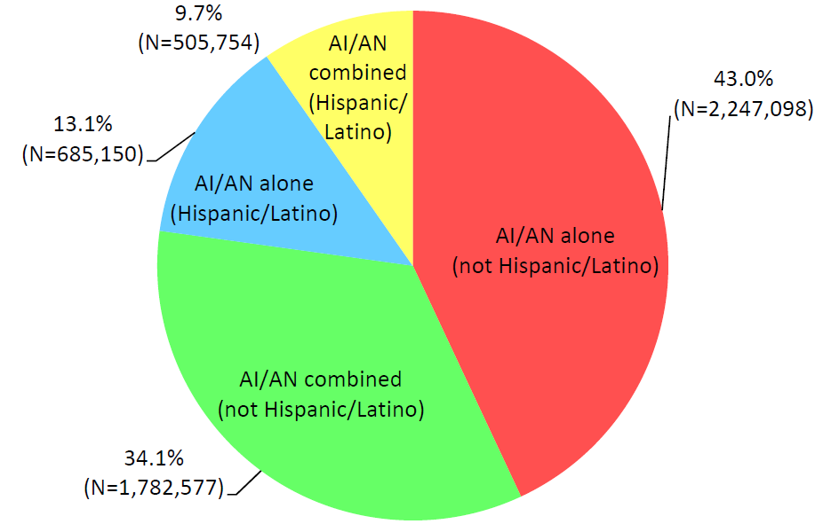
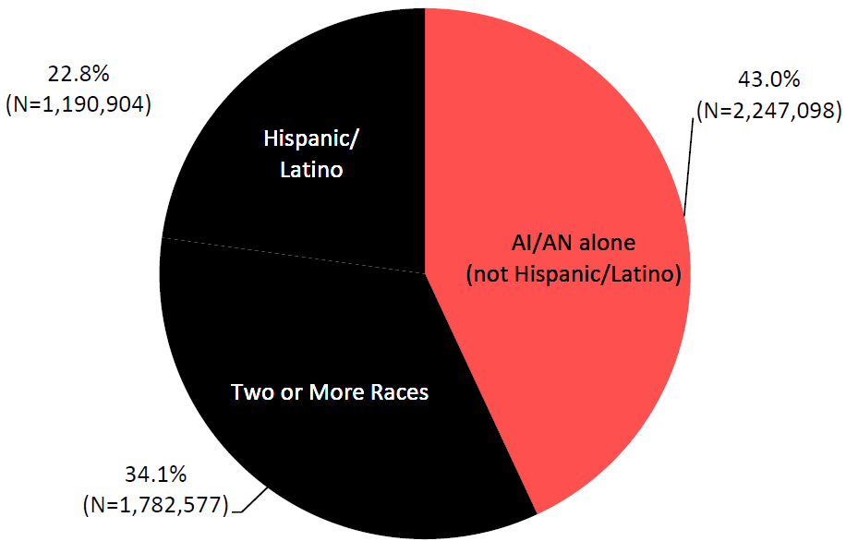
AI/AN Population from 2010 Census
(Humes, Jones, & Ramirez, 2011)
Notes:
Total = 5,220,579 (Hisp/Latino & non-Hisp/Latino)
22.8% (N=1,190,904) of AI/ANs also identify themselves as Hispanic/Latino
43.8% (N=2,288,331) of AI/ANs identify themselves as associated with at least one other race.
Total = 5,220,579 (Hisp/Latino & non-Hisp/Latino)
Black is used to emphasize individuals who aren’t counted in most reports of AI/AN population
Example of how many AI/ANs may be excluded:
Here’s one example, according to The Condition of Education 2011 report, using data from the Current Population Survey. The number of prekindergarten through 12th grade AI/AN students in the nation’s public schools dropped by half from 622,000 (1.2%) in October 2002 to 314,000 (0.6%) in October 2003, after the “Two or more races” category was introduced to the survey. Data for NHOPI students weren’t reported.
Mention solutions to the problem of using the racial categories:
One, in a resolution passed I 2011 by NIEA membership, recommends:
Combining all Native students into one category: AI, AN, NH
All AI/AN/NH students who identify as AI/AN/NH are counted as AI/AN/NH regardless of whether they are also Hispanic/Latino ethnicity and/or in combination with any other race

Slide 10
Tribal Use of Data & Indicators
Culturally-Based Indices & Indicators
Alaska Native K-12 Indicators Report (First Alaskans Institute, 2004)
Ka Huaka’i: Native Hawaiian Ed. Assessment (Kamehameha Schools, 2005)
AIHEC AIMS Fact Book (2009)
Language Efforts
Status
Gap Comparisons
Native-to-Native Comparisons
Trend Analysis & Longitudinal
Use of multiple data sets
Partners:
National Indian Education Association
National Congress of American Indians
Tribal Education Departments National Assembly
American Indian Higher Education Consortium
Notes:
Real potential to use data that this specifically reported on AI/AN peoples and contexts of significance
Existing resources & projects (Data Quality Campaign)
Opportunities
Partners: NIEA, NCAI, TEDNA, AIHEC

Slide 11
Priority Data Issues
ED Implementation of OMB 1997 Regulations
Access to tribal-level data
Age, Appropriateness, Accuracy, & Availability of Data
Meaningful Comparisons
Need for cross-agency measures
Education, training, technical assistance for tribes & AI/AN data users
Notes:
Final Guidance on Maintaining, Collecting and Reporting Racial and Ethnic Data (U.S. Department of Education, 2007)
“When aggregating local data for federal reporting…the seven aggregate categories for reporting to USED are:
Hispanic/Latino of any race;
and, for individuals who are non-Hispanic/Latino only:
American Indian or Alaska Native,
Asian,
Black or African American,
Native Hawaiian or Other Pacific Islander,
White, and
Two or more races.

Slide 12
Recommendations
Urge USDOE to report on all AI/AN indicators collected
Openly consult with tribes
Inclusion & oversampling AI/AN populations, esp. in longitudinal studies
Coordinate data collection across NCES and others (Census, Civil Rights, Labor)
Funding (for NIES, SASS, ACS, BLS, CPS)
Training & Technical Assistance (for tribal users and agency staff)
Notes:
Other ways to mitigate
Hold-harmless Provisions
Count Question Resolution
Census Challenge Program
Tribal Consultation
Monitoring by AI/AN Advocacy Orgs

