Slide 1
IHS Sequestration FY 2013
In FY 2013, IHS subject to 5.1% cut
$220 million
$240 million in automatic cuts since FY 2011
Exempt: Social Security; Medicaid; CHIP; SNAP; child nutrition; SSI; Child Tax Credit; EITC; Veterans benefits; federal retirement; state unemployment benefits; Pell grants

Slide 2
Sequestration FY 2013

Slide 3
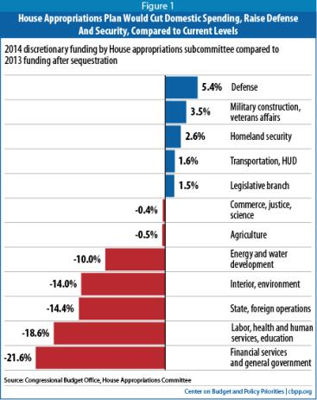
FY 2014 IHS Appropriations Outlook
IHS Funding so far:
House Bill: $4.1 billion (equal to FY13 post sequestration)
Senate Bill: $4.4 billion (increase of $3.8M)
During House Interior Markup Betty McCollum (D-MN) offered an amendment to protect IHS from future cuts greater than 2%.
Amendment was defeated, but it also included a lot of other provisions
Notes:
House has passed 4 of 12 bills so far (Defense; Energy and water; Homeland Security; MilConVA)
10 bills have passed committee – Interior and Labor H have not passed committee yet
Interior Markup expected to continue
Unknown if House has votes to pass more controversial bills
Senate has not pass any appropriations bills.
11 have passed committee – all except Interior. Released a draft bill just before end of session
Most bills in both house and senate are passing along party line votes.

Slide 4
Sequestration
Think about how you can tell your story on sequestration:
How many patients will go untreated?
What health services will you deny cut back?
Will you have layoffs of health professionals?
Will you close any health clinics? Reduce hours?

Slide 5
Sequestration
If you don’t know, estimate.
The Sault Ste. Marie Tribe looked at their baseline budget and estimated what the amount of funding cuts would look like for FY 2013.
For example, the Tribe estimated that for FY 2014, a 9 percent sequestration cut would be about $1.5 million.
This means the elimination of two Dentists, four dental technicians, three family practice physicians and three registered nurses.
The amount of people the Tribe could actually treat would be reduced by 12,400 or 23 percent of primary care visits. Sequestration also decreased third party revenue by over $700,000

Slide 6
Sequestration
Personal stories are always best. Tell about a patient you had or knew of that received worse care (or no care) due to an inadequate budget.
Will sequestration affect 3rd party revenue?
Do you know what the health statistics are on your reservation?
Emphasize that it is not an entitlement, not because you are a minority but is a trust responsibility.
American Indians/ Alaska Natives prepaid for their health care in exchange for land and peace

