Slide 1
Finding Common Ground, Honoring the Promises
Presented by:
Amber Ebarb (National Congress of American Indians), Clint Bowers (National Indian Education Association), Caitrin Shuy (National Indian Health Board), and Lacy Horn, Treasurer (Cherokee Nation)
September 4, 2013
Notes:
Welcome to all of the tribal leaders, officials, and advocates who are taking time to hear about our efforts to ensure the trust and treaty promises to Indian Country are protected in this touch fiscal environment. We are joined by the National Indian Health Board, the National Indian Education Association, and the Cherokee Nation on this webinar. Many of you are experts on federal budget issues I’m sure, but we want to make sure we continue working together with similar messages.

Slide 2
Agenda
National Congress of American Indians
Why now is the time to act.
Budget timeline and recent activity.
Sequester’s impact on funding for tribes.
Treaty Promises are Bipartisan
Analysis of Media Stories about Tribes and Sequestration
National Indian Health Board
Impacts on Indian Health Service
National Indian Education Association
Impacts on Indian Education
Cherokee Nation
How tribes can develop effective sequester impact reports and stories.

Slide 3
Purpose and Upcoming Events
Tribal Unity Impact Days, September 11-12, 2013 in DC
Tribal Leader Briefing on 9/11 from 9am-noon. Register, set up meetings with your delegation.
Also, Native American Caucus to hold a Sequestration Briefing for Hill Staffers
Notes:
First, this webinar is to help tribal leaders and advocates prepare for next week, our third Tribal Unity Impact week. This effort each fall has been very successful in advancing key issues to tribes and tribal sovereignty. We have focused on the VAWA fix and Stafford Act. Again, we will focus on budget/appropriations issues, Carcieri, and tax policy this time. Thank you to everyone who has participated in the past. Your involvement is critical to the success of this effort.

Slide 4
Now is the Time for Tribal Unity in Urging Congress to Honor Treaty Promises
A dangerous narrative,
because we are hearing differently from Indian Country:
Cuts to Native staff are simply increasing an unemployment rate that often exceeds 50 percent in some areas. “Many times these staff are the primary breadwinner in the families. So we are taking an independent family and saying, 'No, you're unemployed, and you've become dependent on this other system [federal unemployment benefits].’”
More media and decision-makers must hear about these effects.
Notes:
So, why is now an important time to be engaged? A dangerous narrative has emerged, and although not everyone agrees, it has taken hold. Because the sequester cuts have been more slowly absorbed in some communities than others, some politicians and commentators insist that federal agencies and the government can absorb the burden of deficit reduction. There may be challenges in tracking this information as tribal leaders and administrators, because after all, we’ve been dealing with shortfalls many times before and have learned how to deal with it. But now is an important time to track and begin sharing impacts.

Slide 5
Where are we? …in desperate need of finding common ground.
FY2013: Starting to see sequestration impacts
FY2014: Different budget frames
House Budget Resolution and 302(b)s
Senate Budget Resolution and 302(b)s
Some bills moved despite budget incongruity
Next Steps:
CR is likely; Democrats may seek sequester replacement for CR votes
Debt ceiling will need to be raised in mid-October
FY2015: FY15 planning has begun
Notes:
Here is a quick summary of where we are and the deep divide between the House and Senate. As a reminder, in March, the sequester was ordered for FY13. (A 5% cut to NDD, amended by the fiscal cliff deal down from 8 percent). On March 21, the FY 2013 CR passed, avoiding a government shutdown but it left sequester in place. Right now, we are starting to see real consequences of the reductions, although slowly in some cases.
For FY 2014, in April , the President’s Budget was released, which replaced sequestration through 2021. The Senate’s budget resolution follows suit in. So for FY 2014, we have at least two different budget frames. We have the House budget resolution and 302(b) allocations for spending bills and the Senate budget resolution and allocations.

Slide 6
FY2014: Starkly Different Options
House Appropriations Plan
It leaves overall sequestration in effect for FY14
The House’s topline discretionary cap would be at the FY14 level after sequestration as called for in the BCA
$966 billion
It overrides a key provision of the BCA and shifts billions of dollars from domestic programs to defense and security programs
BCA required equal cuts in Defense and non-Defense
It increases defense funding by $47 billion and reduces domestic spending by the same.
House plan reduces the pressure on conservatives to replace sequestration with other deficit reduction
Senate Plan
FY14 spending cap is at the BCA level before sequester, $1.058 trillion.
The gap is over revenue increases versus entitlement changes.
Notes:
How are the plans so different? The House Appropriations plan follows the House Budget Resolution. The House budget plan leaves sequestration in effect for FY 2014. OMB ordered sequestration on April 10 and corrected its order on May 20. The order immediately reduced the cap on discretionary spending for fiscal year 2014 from $1.058 trillion to the $967.5 billion level.
When people ask, what will FY 2014 sequestration look like, you can examine it in the House levels, even though our champions in the House did their best under the tough allocations they had.
The House wanted to pass their appropriations bills totaling $966 billion. The Senate has said it will pass bills totaling $1.058 trillion, the FY14 spending cap set before sequester by the BCA and amended by the (ATRA) American Taxpayer Relief Act of 2012. The difference – $92 billion – surpasses the total funding for the Transportation Department, or the combined budgets of both the Department of Education and Energy. If you’re expecting compromise, just remember the difficulty Congress had for 2013 spending where the gap between the chambers was only $29 billion.
Any compromise above $966 billion (without specific provisions vitiating the sequester) will set off a sequester for 2014 discretionary spending. By mid-January of calendar year 2014, the sequester would hit the annual appropriations bills. The economic impact of such a second sequester will exacerbate the very problem of fiscal policy impeding growth.
The issue that divides is familiar: overhauling the tax code or making structural changes to entitlement programs for several years: The administration insists that any major fiscal plan include additional revenue generated by closing tax breaks for upper-income earners; Republicans remain opposed to a tax increase. The GOP says it favors raising revenue, but only through the economic growth Republicans say would result from simplifying the tax code.

Slide 7
Percent Cut in non-Defense Discretionary compared to FY10, Inflation Adjusted
1st Cut, Avoiding Shutdown
2nd Cut, Due to BCA
Caps
3rd Cut, Sequestration
Source: Center on Budget and Policy Priorities
Notes:
So all of the pressure has been on appropriations, including treaty promises. This shows the cumulative impact of the three waves of cuts imposed on non-defense discretionary. It shows reductions compared to FY2010 levels adjusted for inflation, which is when the first crises started. FY2011 included reductions to domestic spending as part of a deal to avoid a government shutdown. The second wave of cuts was the Budget Control Act caps, which we are under until 2021. The third wave of reductions to domestic spending is the sequester.
The house plan would add another round of reductions on tope of the sequester – because on top of using the post-sequester level for discretionary spending, the plan shifts the funding from non-Defense to Defense.

Slide 8
FY2014 House vs. FY2013 excluding sequestration
Source: Center on Budget and Policy Priorities
Notes:
If we look at the fourth wave of cuts under the house plan, Appropriations Subcommittees are writing bills under these allocations. The Interior appropriations bill, which funds BIA and IHS, is working under an allocation that is 19% below the FY 2013 level before sequestration went into effect. The labor-HHS-Ed committee planned a markup but then postponed it. And we all saw what happened with the Transportation HUD spending bill on the floor of the House. And including sequestration, the Interior allocation is 14% below the FY13 level.

Slide 9
Sequestration: Tribes Losing Ground Critical Governmental Services
FY10 Level
Sen: Δ = -3% vs. FY10
Nominal
Pres/ Senate
House: Δ = -9%, -$210 M vs. Senate
House
NCAI Analysis, BIA Budget
Notes:
Given the overall constraints on appropriations bills, here is the impact of the recent cuts on the core tribal governmental services at BIA. This includes public safety, natural resources, child welfare, welfare assistance, HIP, scholarships, BIE and others. Heading into FY2006, the civil rights commission called the state of funding for BIA and in all agencies to be in a quiet crises of disparaties in underfunding. With ARRA and support in 09 and 10 in Congress, we started to address it. But comparing the Senate versus House levels shows us the impact.
The Senate, with fully replacing sequester is still 3% below 10 levels. The House is 9% below the Senate, so 12% below 10. But this doesn’t account for inflation.

Slide 10
Sequestration: Tribes Losing Ground Critical Governmental Services
Nominal
FY10 Level
Inflation adjusted
Sen Δ =
-11% from FY10
Pres/Senate
Adjusting for inflation, even the PB/Senate level is lower than FY06 levels
House Δ = -19% from FY10
House
NCAI Analysis, BIA Budget
Notes:
Accounting for inflation, the Senate level is 11% below FY10still. In fact, it’s lower than the FY06 level. It’s takes us back 6 years. And of course the House is much worse – the two issues being inflation and not addressing the sequester. That drops critical tribal governmental services to 19% below the FY10 level. And lower than anytime in the last 8 years. The projections don’t improve unless we can take the pressure off.
FY14-FY10
PB, -2.8%
House, -11.8%
Senate, -3.0%
FY14-FY10
Inflation adjusted
PB, -11.2%
House, -18.6%
Senate, -11.4%

Slide 11
FY14 Appropriations Activities
Interior-Environment Bill
Very contentious, due to environmental policy riders and wildlife protection programs.
House Subcommittee markup held July 23. Full Cmte July 31 Senate will likely release a draft but not mark it up.
Transportation HUD
NAHASDA block grant cut from $650M to $600M
Cole’s office said they will work with the Senate side to restore it towards the end of the approps season.
House Appropriations Chairman Harold Rogers (R-KY) commented that, "With this action [pulling the T-HUD bill from the floor], the House has declined to proceed on the implementation of the very budget it adopted just three months ago," referring to the House budget resolution written by Congressman Paul Ryan (R-WI). He added, "The House, Senate and White House must come together as soon as possible on a comprehensive compromise that repeals sequestration, takes the nation off this lurching path from fiscal crisis to fiscal crisis, reduces our deficits and debt, and provides a realistic top-line discretionary spending level to fund the government in a responsible and attainable way."

Slide 12
House vs. Senate on Contract Support Costs
Significantly, the House bill does not include the contract support costs cap language that has been in the bill for about a decade.
The bill rejects the Administration’s proposal for individually capping contract support costs.
The bill also does not include the separate account for contract support costs.

Slide 13
Common Ground: Upholding Treaty Promises is Bipartisan
Congressman Simpson (R-ID), Interior Subcommittee Chair: "This bill makes critical investments in Indian County-an area of strong interest to the bipartisan Members of this subcommittee. Members on both sides of the aisle agree that sequester is having a negative impact on these health accounts, affecting some of the most vulnerable of our Native American brothers and sisters. We're not able to turn off sequester in our bill but we must work together to carry that message to the Budget Committee and hopefully get this resolved.“
Congressman Don Young (R‐AK): “I believe very strongly that if you read the Constitution and our agreement with the American Indians and Alaska Natives, we have an obligation…And I don't want to see us balancing the budget on the backs of those we have an obligation to.“
Congresswoman McCollum (D-MN): While Medicare, Medicaid, etc are protected from sequestration, IHS will be cut. "When it's the morally right thing to do and when the federal government has a legal responsibility through treaties to provide this, to tell Indian Country, ‘you're affected by sequestration, the rest of the United States population is not.' That's morally wrong. A bipartisan group of House members wants to protect Indian Health Services from sequestration. But House leaders say other programs will need to be cut if money is restored to Indian Health Services.
Senator Murkowski (Appropriations and SCIA): "Self-determined contracts are the core of our nation's federal trust relationship with Indian tribes. …tribes operate the federal programs promised to Indians for the removal of their lands. This is a federal responsibility that exists in strong budget times and, most importantly, in difficult budget times as well.“
Senator Franken (D-MN): “The severe cuts made to programs that benefit Native American students are a distressing reminder of why we need to replace the entire sequester…. Children in Indian Country are hurting because of the sequester, and it’s only going to get worse if we don’t get something done.”
Congressman Cole (R-OK): “The cuts in the BIA the Office of Special Trustee are well below the 19% in the entire budget. And I have no doubt if our allocation gets better that those things will be addressed in appropriate fashion as well. So this bill does prioritize and continues in a bipartisan way to prioritize funding in Indian Country and fulfilling our treaty obligations and trust obligations to Native American nations and I’m proud of that and again that wouldn’t have happened without my friend the chairman but it wouldn’t have happened without my friends on the other side of the aisle, who I know care as deeply about this issue as certainly I do.”
Notes:
Fortunately, we believe upholding treaty promises is a bipartisan issue. We just need to encourage policymakers to replace the sequester so that the trust and treaty obligations funded in the federal budget are upheld.
We have Congressman Simpson from Idaho, who is a strong proponent of BIA and IHS. He acknowledges he couldn’t turn off the sequester as an appropriator, but they want to work with the budget committee to exempt at least IHS. Other

Slide 14
Analysis of Media Stories of Tribes and Sequester
NCAI Reviewed 38 Recent News Articles, Radio Segments, and Blogs
The stories and articles covered impacts to tribes in the states below.
Notes:
So what messages have worked? I reviewed recent media coverage of the effects of the FY 2013 sequester on Indian Country and tribal programs in the federal budget. The analysis reviews 38 articles, radio segments, and blogs. Many of the stories are catalogued on NCAI’s website. I’ll also share a copy of this draft analysis after the webinar. This report may not be entirely exhaustive, so if tribes or organizations would like to update NCAI’s sequester news stories clearinghouse, contact NCAI staff. The methodology for this analysis was to track Google news alerts beginning in March 2013 for the terms, “sequestration + Indian Country, tribes + sequester, reservations +sequester, tribes + sequestration.”

Slide 15
Programs and Themes Addressed in News Stories
Programs/Areas
Themes in Stories
Notes:
A review of the programs addressed in the stories shows that Impact Aid funding to public schools received the most attention. This is likely due to the fact that Impact Aid dollars are not forward funded and the cuts affected schools more immediately than other Department of Education and Bureau of Indian Education funding streams. Other reasons Impact Aid could be covered is that the National Association of Federally Impacted Schools released numerous reports with detailed data and contact information on the challenges facing public schools. The second highest reported program affected by sequestration was the Indian Health Service.

Slide 16
How Tribes Are Implementing Sequester So Far, according to news stories (March-Sept. 2013)
We walked past the Tuba City High School gym where sun shines through the holes in the ceiling. At the nearby primary school one wing and a cafeteria have already been condemned. That building is in desperate need of new bathrooms and safe playground equipment. But those upgrades will have to wait.
Notes:
One response from Wagner Community School District Superintendent, Linda Foos, South Dakota (Indian lands) sums up this sentiment: “All the cuts possible to supplies, utilities, and extra programs have been made. We are trying to lessen the impact on the classroom, but that doesn’t seem possible.”

Slide 17
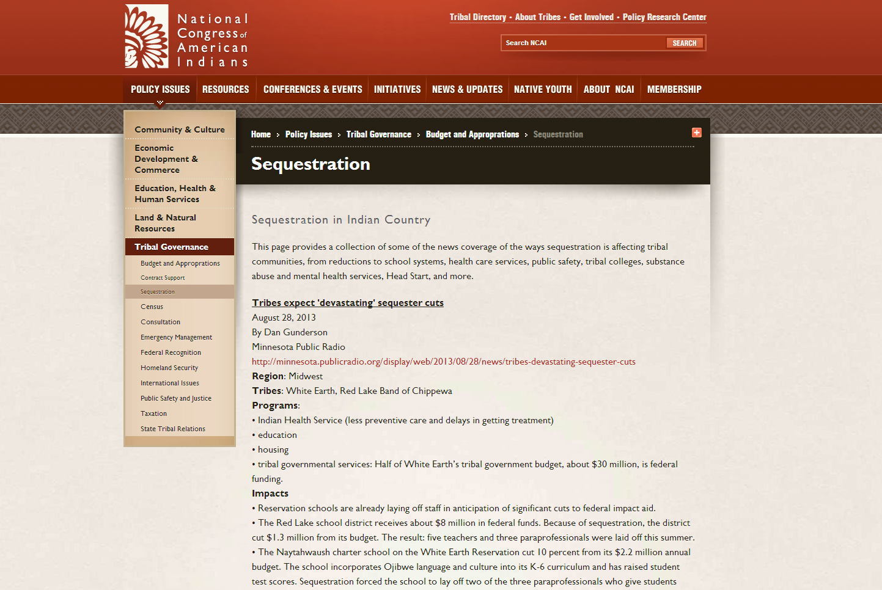
Clearinghouse: http://www.ncai.org/policy-issues/tribal-governance/budget-and-approprations/sequestration
Email aebarb@ncai.org if you would like to add to this.

