Slide 1
Office of Self Governance Funding

Slide 5
Self-Governance Compacts (TPA) Line
Serves as a way for Self-Governance Tribes to consolidate their funding in one place.
The Office of Self Governance is the allottee for these funds.
Not an appropriated line. Base funds are transferred to this line for Self-Governance Tribes.

Slide 6
Self-Governance Compacts (TPA) Line
Internal Transfers
An increase to this line is usually an internal transfer from programs for new Self-Governance Tribes into Self-Governance.
Internal transfers also allow current Self-Governance Tribes to elect a program to be base transferred.
Negative Internal Transfers are programs that Tribes are returning back to the BIA.

Slide 7
Self-Governance Increases
Program increases for Self-Governance Tribes happen when an increase is provided to a program.
The program would provide a prorata, or whatever methodology they are using, to distribute the increase to the Self-Governance tribes the same as is distributed to Self-Determination tribes.
Self Governance tribes have the option of moving those funds into their base Self-Governance Line or having it remain in the particular program funding line within their agreement.

Slide 8
For Example, Climate Change Increase
Issued a Federal Register Notice for Tribes.
Tribes applied.
Sean Hart consulted with OSG and the Regions on the increase process.
Google Drive site developed for OSG and Regions to see the Tribal funding distributions.
Award Letters were sent to Tribes, Region and OSG were copied on the letters.
Award Letters retained in Tribes’ Contract and Compact Files.

Slide 9
For Example, Tribal Courts Increase
Makes a good all-inclusive effort internally.
Has become very good at communication.
Sends the Tribe and OSG Award Letters.
Sends FED (financial transfer) document with any conditions the Tribes must meet.

Slide 10
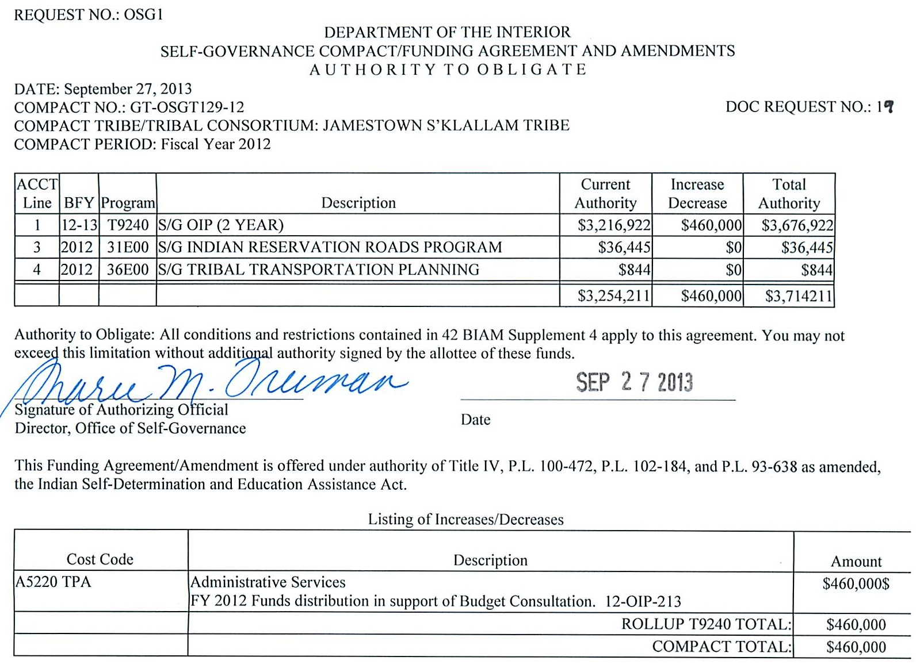
Increase descriptions provided to the Tribe.
Also, any conditions related to funding inserted here.

Slide 11
History of Self-Governance Tribes Sharing in Increases
For example, Scholarship Funding.
A program often provides a pro-rata increase by using the tables in the back of the Greenbook for a particular year.
If a Tribe has Scholarships consolidated in Consolidated Tribal Government Program (CTGP) or Aid to Tribal Government (ATG), they most likely will not get any increase, unless the Program agrees to work with OSG to break out the numbers.
What happens for Self-Determination Tribes?

Slide 12
Process Improvements for Increases
Need stronger lines of communication between Agencies, Regions, Central Office Programs, OSG and Tribes.
Written requests for program increases need to clearly outline all requirements –criteria, reporting, etc.
Written requests should also clearly state that OSG tribes are to be included in the distributions.
When possible, tribes should be consulted on the criteria used for increases, since they are the ones who are supporting the increases.

Slide 13
Process Improvements for Increases
After increase is received, OSG should be consulted and provide data to the BIA related to the criteria used for distribution.
Where can we find notices of increases:
Greenbook
Programs need to post to their websites
Public Affairs should do announcements
Dear Tribal Leader Letter
Meetings and Conferences

