Slide 1
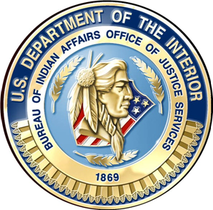
U.S. Department of the Interior Bureau of Indian Affairs Office of Justice Services
Tribal/Interior Budget Council
November 9, 2017 Meeting
Jason Thompson
Assistant Deputy Bureau Director, Justice Services

Slide 2
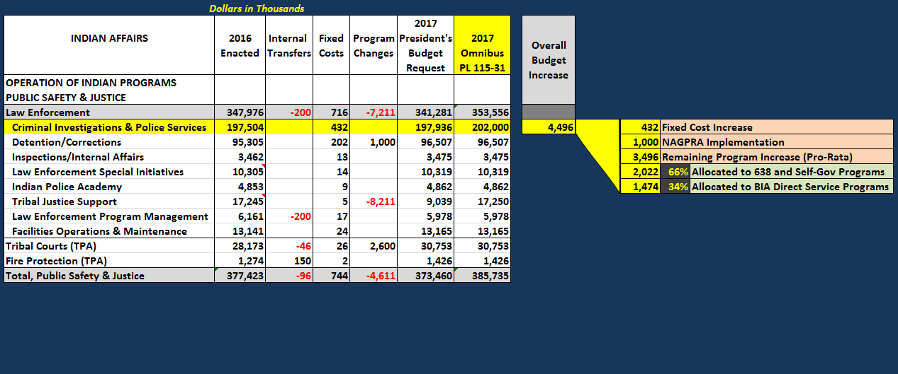
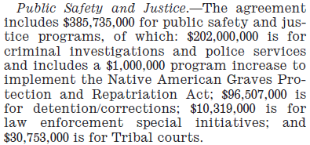
2017 Enacted Funding
CI&P Budget Increase: Pro-Rata Distribution to Base Funding
Appropriations Language:

Slide 3
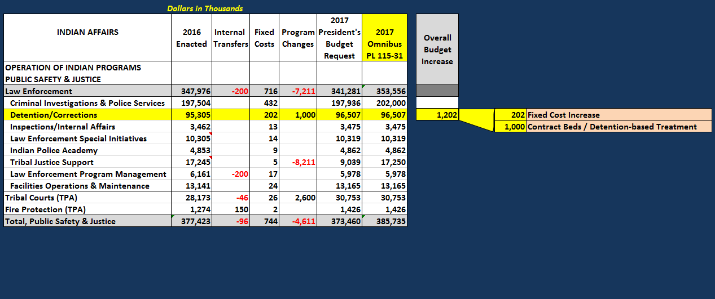
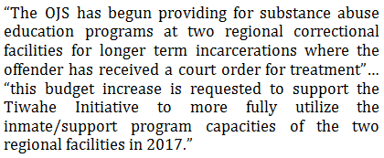
2017 Enacted Funding
Detention/Corrections Budget Increase: Requested in President’s Budget
2017 Greenbook Language:

Slide 4
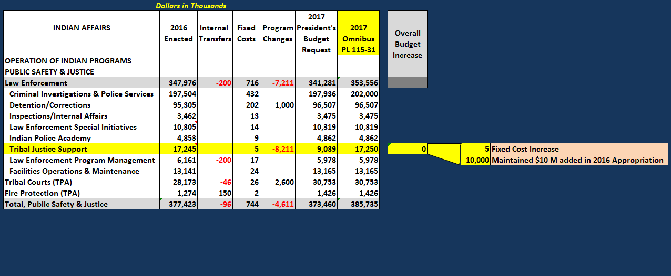
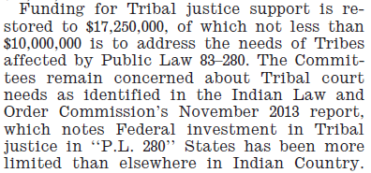
2017 Enacted Funding
Tribal Justice Support Budget Maintained: Decreased in President’s Budget
Appropriations Language:

Slide 5
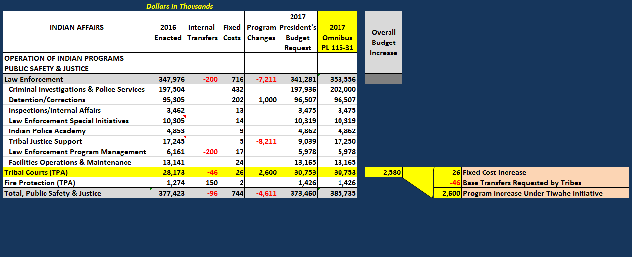
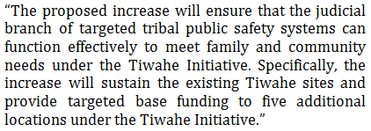
2017 Enacted Funding
Tribal Courts Budget Increase: Requested Under Tiwahe Initiative
2017 Greenbook Language:

Slide 6
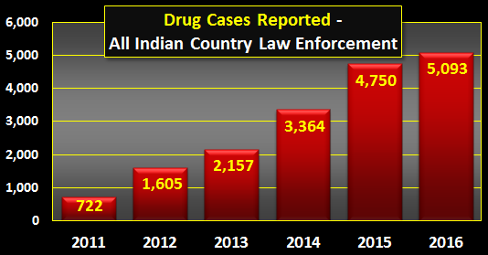
Division of Drug Enforcement
The OJS drug enforcement unit is comprised of 28 BIA criminal investigator positions and 16 school resource officer positions located strategically throughout the nation to function as an integral component of the overall OJS investigative structure.
Drug trafficking and drug related crimes, including the ongoing methamphetamine crisis, continue to escalate throughout Indian country.

Slide 7
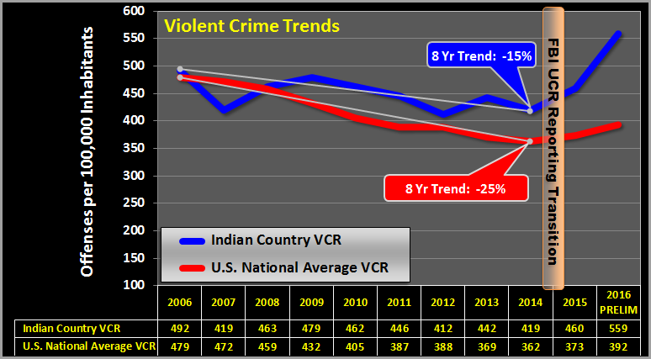
Violent Crime in Indian Country

