Slide 1
Tribal Interior Budget Council
November 19, 2015

Slide 2
Background
In 2014, the Office of Management and Budget (OMB) gave a presentation to Tribal - Interior Budget Council (TIBC) about the 2015 Native American cross-cut that identified resources.
TIBC outlined the need for information to access these resources.
The Native One Stop was developed in response to input from the TIBC.

Slide 3
Proposal 2016
Incorporating this feedback, 2016 Presidential budget requested proposed an increase of $4 million to establish a One-Stop Tribal Support Center.
That center would include an online portal and services to support tribes in accessing federal programs and resources at the regional and local levels.
Technical support staff in both DC and Regions.

Slide 4
Federal Coordination
In collaboration with the Whitehouse Council, OMB and the Department of Labor, we develop the Website and content, for the Native One Stop, which was unveiled this month.
Indian Affairs coordinated efforts across the federal government to gather information on resources by working with the White House Council on Native American Affairs.

Slide 5
Website Launch
At its launch, the site included over 80 different resources with categories such as Education, Employment, Environment, Food, Loans, and Youth.
American Indians and Alaska Natives may answer a series of questions on the site to determine if they are eligible to apply for any of these resources.
Information on additional resources is being added on an ongoing basis.

Slide 8
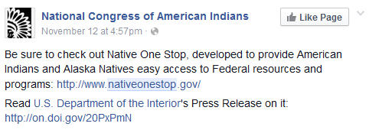

Slide 9
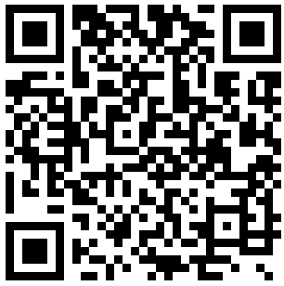
http://www.NativeOneStop.gov/

