Slide 1
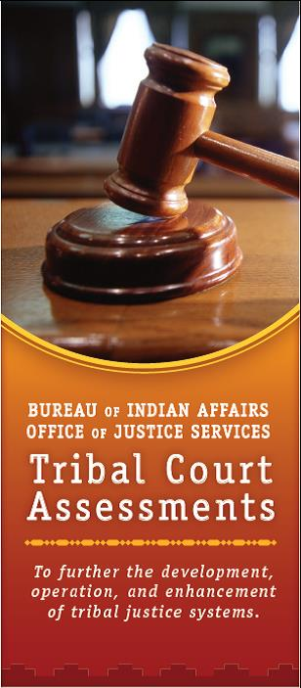
U.S. Department of the Interior Bureau of Indian Affairs Office of Justice Services
Tribal-Interior Budget Council (TIBC)
August 6, 2015
Albuquerque, New Mexico
Tribal Justice Support Directorate
(Tribal Courts)

Slide 2
Office of Justice Services Tribal Justice Support Directorate
Who We Are
Associate Director: Tricia Tingle (Choctaw Nation)
Deputy Associate Director: Natasha Anderson (Yankton Sioux/Ponca)
Civil Law Specialist: Katherine Scotta (Sault Ste. Marie Band of Chippewa)
Diversion & Re-Entry Deputy Associate Director:
Rodney Robinson (Northern Cheyenne Tribe)
National Tribal Court Review Coordinator: [pending]
Administrative Tribal Court Review Coordinator:
Savannah Joe (Navajo Nation)
Staff Assistant: Simone Toya (Pueblo of Jemez)
Law Enforcement Assistant: Wanda Brunson
Tribal-Interior Budget Council (TIBC)
August 6, 2015
Albuquerque, New Mexico

Slide 3
Office of Justice Services Tribal Justice Support Directorate
What We Do
The Tribal Justice Support Directorate (TJS) provides guidance, technical support, and advisory services to tribal courts and CFR Courts (Code of Federal Regulations; also known as Courts of Indian Offenses), including:
providing funding to tribal courts;
training directed to specific needs of tribal court personnel;
promoting cooperation and coordination among tribal justice systems and Federal and state judiciary systems; and
providing oversight for the continuing operations for the Courts of Indian Offenses.
Tribal-Interior Budget Council (TIBC)
August 6, 2015
Albuquerque, New Mexico

Slide 4
Office of Justice Services Tribal Justice Support Directorate
What We Do continued
Statutory Directive: Tribal Court Assessment Program
As mandated by 25 U.S.C. § 3612, TJS works with Tribes to conduct tribal court assessments by using a modified model of the Trial Court Performance Standards (TCPS).
Tribal-Interior Budget Council (TIBC)
August 6, 2015
Albuquerque, New Mexico

Slide 5
Office of Justice Services Tribal Justice Support Directorate Tribal Court Assessment Program
In using a modified model of the Trial Court Performance Standards (TCPS), TJS works with non-federal contractors to assist tribal courts in identifying existing problems and formulating strategies for improvement of tribal courts and provides an outcome-oriented conceptual framework of tribal court performance areas, standards, and measures.
Tribal-Interior Budget Council (TIBC)
August 6, 2015
Albuquerque, New Mexico

Slide 6
Office of Justice Services Tribal Justice Support Directorate Tribal Court Assessment Program
The result is a strategic action plan which is part of the overall assessment report.
It is up to the Tribe to prioritize the needs identified.
TJS will then work with the Tribe to identify available one-time funding as well as training/technical-assistance opportunities.
Tribal-Interior Budget Council (TIBC)
August 6, 2015
Albuquerque, New Mexico

Slide 7
Office of Justice Services Tribal Justice Support Directorate Tribal Court Assessment Program
Why an Assessment?
An Overview of the entire Tribal Court;
Driven by the Tribe’s stated needs;
Expenses of the Assessment Team (i.e., non-federal contractors) are of no cost to the Tribe.
Tribal-Interior Budget Council (TIBC)
August 6, 2015
Albuquerque, New Mexico

Slide 8
Office of Justice Services Tribal Justice Support Directorate Tribal Court Assessment Program
The benefits of a tribal court self-assessment include possible one-time funding for services such as:
Court management system;
Alcohol monitoring system;
Court equipment;
Training for tribal court staff;
Consultant services to work with tribe and court on specific projects (e.g., code development, manuals, bench book).
Tribal-Interior Budget Council (TIBC)
August 6, 2015
Albuquerque, New Mexico

Slide 9
Office of Justice Services Tribal Justice Support Directorate Tribal Court Assessment Program
After a letter from a tribe requesting to participate …
Five-Step Tribal Court Assessment Process:
Step 1: Documentation Gathering;
Step 2: Initial Visit;
Step 3: Three-Day Onsite Assessment;
Step 4: Present Findings and Recommendations;
Step 5: Follow-up and Next Steps.
Tribal-Interior Budget Council (TIBC)
August 6, 2015
Albuquerque, New Mexico

Slide 10
Office of Justice Services Tribal Justice Support Directorate
TJS also tracks and works on other policy areas, initiatives and issues concerning Tribal Courts including:
Tiwahe Initiative
Indian Child Welfare
Juvenile Justice
Diversion and Re-entry
TLOA’s Enhanced Sentencing Provisions
VAWA’s Special Domestic Violence Criminal Jurisdiction
Tribal-Interior Budget Council (TIBC)
August 6, 2015
Albuquerque, New Mexico

Slide 11
Office of Justice Services Tribal Justice Support Directorate References
Email TJS: bia_tribal_courts@bia.gov
Call TJS: (202) 208-5787
Visit the TJS webpage:
http://www.bia.gov/WhoWeAre/BIA/OJS/ojs-services/ojs-tjs/index.htm
Download the Tribal Court Assessment Brochure here: http://www.bia.gov/cs/groups/xojs/documents/document/idc1-030470.pdf
Download a sample Court Assessment Request Letter here: http://bia.gov/cs/groups/xojs/documents/document/idc1-031263.doc
Tribal-Interior Budget Council (TIBC)
August 6, 2015
Albuquerque, New Mexico

Slide 12
Office of Justice Services Tribal Justice Support Directorate
Thank you!
Please do not hesitate to reach out and let TJS know how we can better support Tribal Judicial Systems.
Tribal-Interior Budget Council (TIBC)
August 6, 2015
Albuquerque, New Mexico

