Slide 1
Indian Affairs Fiscal Years 2017- 2019 Budget Update
George W. Bearpaw, Director
Office of Budget & Performance Management
Tribal Interior Budget Committee - July 25-27, 2017

Slide 2
2017 Distributions
Public Law No. 115-31, Consolidated Appropriations Act, 2017 - May 5, 2017.
Delays incurred due to late apportionment and warrant issuance.
All base funding has been distributed.

Slide 3
2017 Comparison Table
 | 2017 Indian Affairs Comparison Table (dollars in Thousands)
 | Activity | FY 16 Enacted | FY 17 Presidents Budget Req | FY 17 Omnibus P.L. 115-31 | Omnibus vs FY 16 Enacted
 | Tribal Govt | 301,517 | 307,148 | 308,185 | 6,668
 | Human Services | 147,004 | 164,161 | 159,161 | 12,157
 | Natural Resources | 191,846 | 215,597 | 200,992 | 9,146
 | Real Estate Services | 127,486 | 136,192 | 123,092 | -4,394
 | Public Safety and Justice | 377,423 | 373,460 | 385,735 | 8,312
 | Community and Econ Dev | 40,619 | 42,844 | 41,844 | 1,225
 | Exec Dir and Admin Svcs | 229,662 | 243,954 | 228,824 | -838
 | TOTAL BIA | 1,415,557 | 1,483,356 | 1,447,833 | 32,276
 | Education | 852,367 | 912,430 | 891,513 | 39,146
 | Contract Support | 277,000 | 278,000 | 278,000 | 1,000
 | Educ Construction | 138,245 | 138,257 | 133,257 | -4,988
 | Public Safety and Justice Construction | 11,306 | 11,306 | 11,306 | 0
 | Resource Mgmt Construction | 34,488 | 36,513 | 36,513 | 2,025
 | Other Program Construction | 9,934 | 10,941 | 10,941 | 1,007
 | TOTAL CONSTRUCTION | 193,973 | 197,017 | 192,017 | -1,956
 | Settlements and Misc Payments | 49,475 | 55,155 | 45,045 | -4,430
 | Guranteed Loan | 7,748 | 7,757 | 8,757 | 1,009
 | TOTAL | 2,796,120 | 2,933,715 | 2,863,165 | 67,045

Slide 4
FY 2018 President’s Request
Indian Affairs’ 2018 request is $2.488 billion, an overall decrease of $303.2 million below the 2017 planning level (CR).
The 2018 Budget for the Operation of Indians Program (OIP) appropriation, a decrease of $181.1 million below the 2017 planning level (CR).
Includes additional investments in infrastructure.
Maintains funding for energy development.
Prioritizes programs serving Tribes nation-wide and eliminates pilot programs that serve few Tribes.

Slide 5
FY 2018 President’s Request
ROADS
+$1.2 million for deferred maintenance (DM) of BIA-owned roads
IRRIGATION O&M
+$2.6 million for new needs at NIIP
INDIAN IRRIGATION REHAB/SURVEY & DESIGN
+$2.2 million for DM at 16 revenue generating irrigation projects
DAMS
+$4.3 million for Safety of Dams program responsible for 137 high or significant-hazard dams located on 42 Indian reservations in 13 States
BIA FACILITIES
+$2.0 million additional funding for DM at 127 regional and agency facilities will address safety, security and handicap accessibility issues where Indian programs are administered

Slide 6
FY 2018 President’s Request
Tribal Priority Allocations (TPA)
proposes $627 million, $62.9 million below the 2017 CR level
Self-Governance Compacts (TPA)
proposes $156.6million, $5.3 million below the 2017 CR level
Contract Support Costs
proposes $241.6 million, $35.4 million below the 2017 CR level
Fully funds CSC at proposed funding levels
Settlements
$14 million for settlements
Continues to meet Federal commitment to honor enacted settlements
No enacted settlements due to be completed in 2018
Fixed Costs
$17.3 million for fixed costs

Slide 7
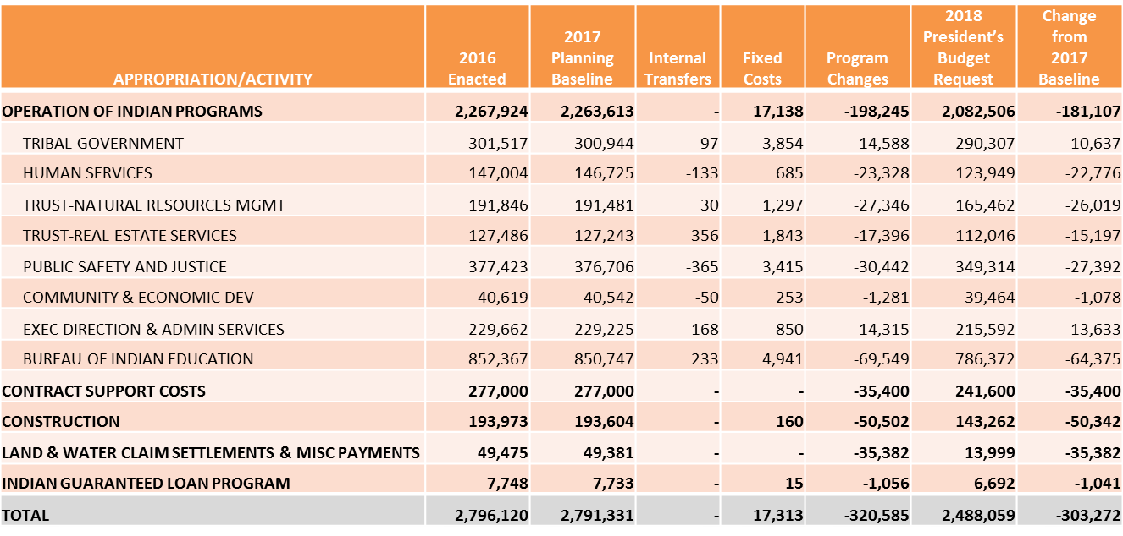
Indian Affairs 2018 Request (Dollars in Thousands)

Slide 8
FY 2018 House Full Committee Markup (Dollars in Thousands)

Slide 9
FY 2019 Budget Formulation
FY 2019 Department Submission
Indian Affairs submitted the Departmental Budget Submission on July 7, 2017.
Continued focus on infrastructure and energy development.
Programs that serve tribes on a nation-wide basis.

Slide 10
Office of Budget & Performance Management
Thank you

