Slide 1
L A N D
B u y - B a c k
P r o g r a m
f o r
T R I B A L
N A T I O N S
Tribal-Interior Budget Council
Flagstaff, Arizona July 26, 2017
www.doi.gov/buybackprogram

Slide 2
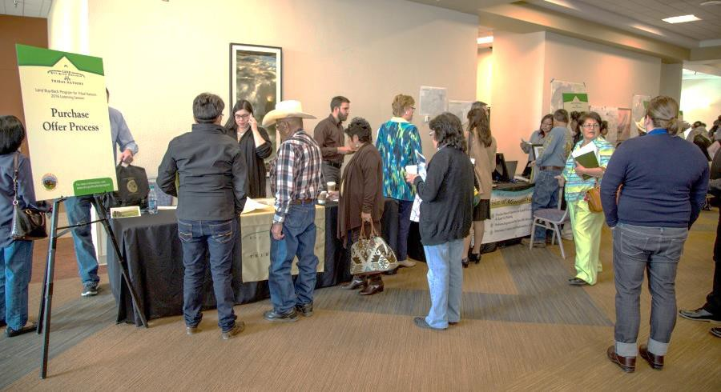
What is the Buy-Back Program?
The Land Buy-Back Program for Tribal Nations implements the land consolidation component of the Cobell Settlement Agreement.
The Settlement provided a $1.9 billion fund
to purchase:
fractional interests
in trust or restricted land
from willing sellers
at fair market value
within a 10-year period.
March 2016 Listening Session
Purchased interests will be immediately held in trust for the tribe with jurisdiction over the land.

Slide 3
Overall Program results thus far
Land Consolidation
Consolidated more than 2.1 million equivalent acres of fractionated land
Purchased nearly 720,000 interests on more than 41,000 tracts
Mailed offers to landowners with interests at 44 locations
Increased tribal ownership to at least 50% on more than 13,900 tracts
Paid more than $1.2 billion to individuals who chose to sell
Implementation Costs
Expended 27% of the $285 million authorized for implementation costs
Entered into agreements with 46 tribes

Slide 4
Strategy Review Period: How can we maximize the
number of interests consolidated with the funds remaining?
Leadership evaluating Program progress and considering factors
such as:
Revision to the schedule of locations (add, remove, or
return to locations)
Land value and interest size (e.g., <25%)
Leveraging Program implementation processes

Slide 5
How can we maximize the number of interests
consolidated with the funds remaining?
The Program can purchase more interests at locations with relatively
lower land values.
Location A $9,000
Location B $5,000
20% 20% 60%
20% 20% 20% 20% 20%

Slide 6
How can we maximize the number of interests
consolidated with the funds remaining?
The Program can purchase more interests on tracts with smaller-sized
interests.
Tract A $9,000
Tract B $5,000
20% 20% 60%
20% 20% 20% 20% 20%

Slide 7
Potential to leverage implementation processes
Tribal Purchases. Should the Program leverage its implementation infrastructure to support tribal land consolidation programs where tribal funds are used to consolidate interests?
Co-Owner Purchases. Should the Program develop processes to encourage and support co-owner purchases?
Sale of Acquired Interests. Should the Program seek to convey acquired
interests to individual landowners, pursuant to existing authority at 25
U.S.C. 2212(c), recognizing that interests so conveyed to individuals may fractionate and that tribal consent is required when the tribe owns an undivided interest in the tract?
Appraisal Validity. Should the Program strive to maintain the appraisal validity for up to 12 months in order to maximize investment made, particularly at cost-efficient locations, and to better enable tribal and co- owner purchases?

Slide 8
Strategy Review Period: Announcements-Activities (2017)
Tribal Leader Letter of March 20
Fed. Reg. Notice, April 12, 82 FR 17681
Listening Session at Tulalip, April 25
Tribal Leader Letter of May 9
Affiliated Tribes of Northwest Indians Mid-year, May 23
Great Plains Tribal Chairman’s Association, Inc., June 21
Partners in Action Conference, July 18
Through 6/5/17, the Program received 53 responses from representatives of 41 locations, including 3 comments from members of Congress.
Results to be announced in the near future

