Slide 1
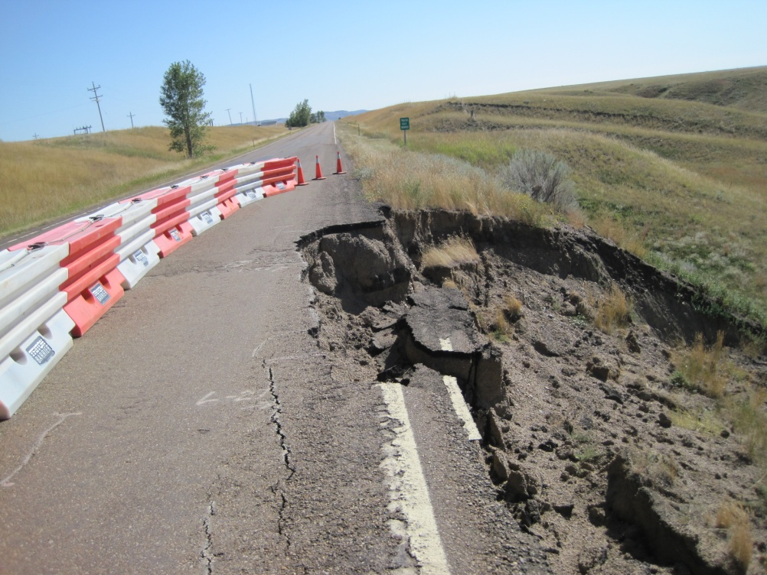
Road Maintenance and Safety: Chronic Shortfalls in Federal Funding for the BIA Road Maintenance Program Undermine Transportation Safety and Economic Development in Indian Country
John Smith, Transportation Director, Shoshone and Arapaho Tribes and
Executive Director for the Intertribal Transportation Association (ITA), and
Matt Jaffe, Partner
Sonosky, Chambers,
Sachse, Endreson
& Perry, LLP
August 4, 2015
Damaged road on the Fort Peck Reservation

Slide 2
BIA Road Maintenance Program
The Bureau of Indian Affairs (BIA) Road Maintenance Program covers the distribution and use of federal appropriations provided by Congress to the BIA in the annual Department of the Interior and Related Agencies Appropriation Acts to maintain transportation facilities in Indian country.

Slide 3
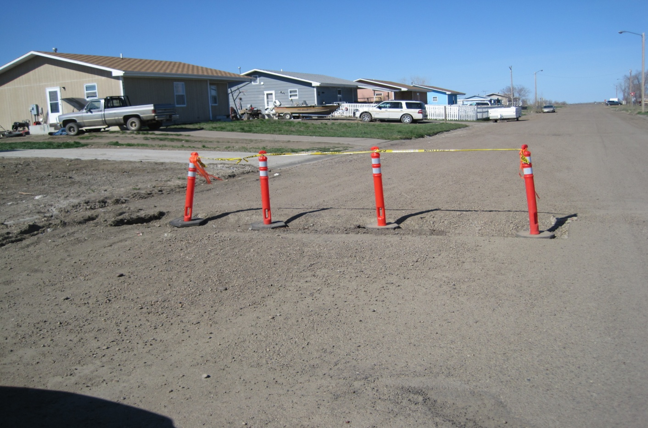
BIA System and tribally-owned roads and bridges are public corridors through which essential services (educational, medical, public safety, commercial and recreational/tourism) are provided to Native American communities. If not routinely maintained, Tribal Transportation Program roads deteriorate quickly and require costly repairs or reconstruction.
Residential Street – Fort Peck Reservation.

Slide 4
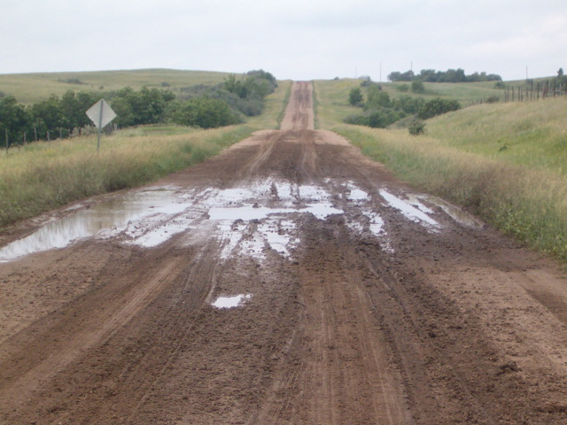
Federal appropriations for the Road Maintenance Program have averaged only $24.3 million annually for the last 30 years; an amount wholly inadequate to properly maintain 29,500 miles of BIA System roads, 17,950 miles of Tribally-owned roads and 930 BIA- and Tribally-owned bridges. As a result, poorly maintained roads and bridges contribute to road hazards and make roads in Indian country inherently unsafe and dangerous to every motorist and pedestrian.
Dirt road on the Fort Berthold Indian Reservation.

Slide 5
General attributes of Tribal Transportation Program (TTP) Transportation Facilities:
Among the most rudimentary of any transportation network in the country (akin to third-world conditions);
Over 66% of the TTP contains unimproved, earthen and gravel roads;
Many miles of TTP roads are impassable immediately following rainstorms;
Many BIA System roads are in only fair condition and were not built to an “adequate design standard” (not built for vehicular traffic volume and traffic speeds in effect today) (originally built as logging and utility roads, etc.) and therefore have many safety deficiencies that contribute to the unacceptably high motor vehicle crash and motorist injury/fatality statistics Indian tribes experience today (e.g., no sidewalks, guardrails, adequate shoulders).

Slide 6
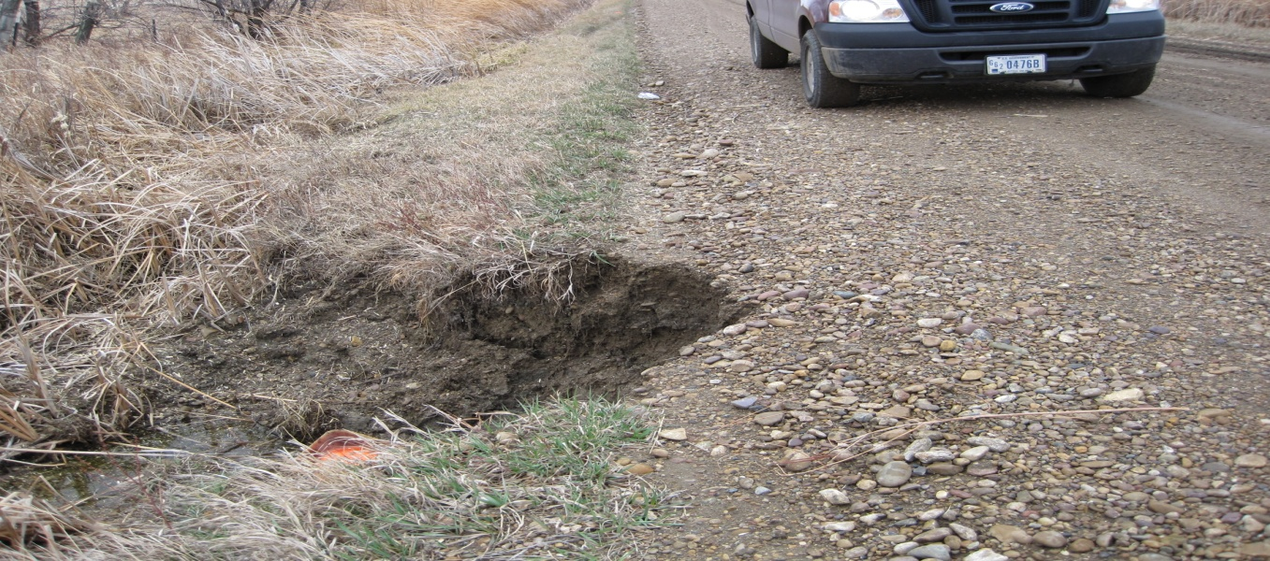
Ten-Year Funding Averages: BIA Road Maintenance
(1981-2015):
1981-1990: $23.2 mil. (avg.)
1991-2000: $23.1 mil. (avg.)
2001-2010: $26.7 mil. (avg.)
2011-2015:__$25.6 mil. (avg.)
FY 2015: $26.46 (enacted)
FY 2016: $26.69 mil. Proposed
The 30-Year Average for the BIA Road Maintenance Program (1981-2015) is $24.65 million annually. In 1990, the Road Maintenance Program was funded at $30.5 million, roughly $4.0 million above the current FY 2015 funding level.
Deteriorating road conditions on the Fort Peck Reservation.

Slide 7
Keeping Pace: As Congress debates funding for the Tribal Transportation Program in the next highway bill, Road Maintenance Program funding in the Interior Appropriations bill must keep pace to ensure the full useful life of newly built or reconstructed Tribal Transportation Facilities. Otherwise, tribal facilities will deteriorate quickly and will need to be reconstructed far sooner. Where will funding come from?

Slide 8
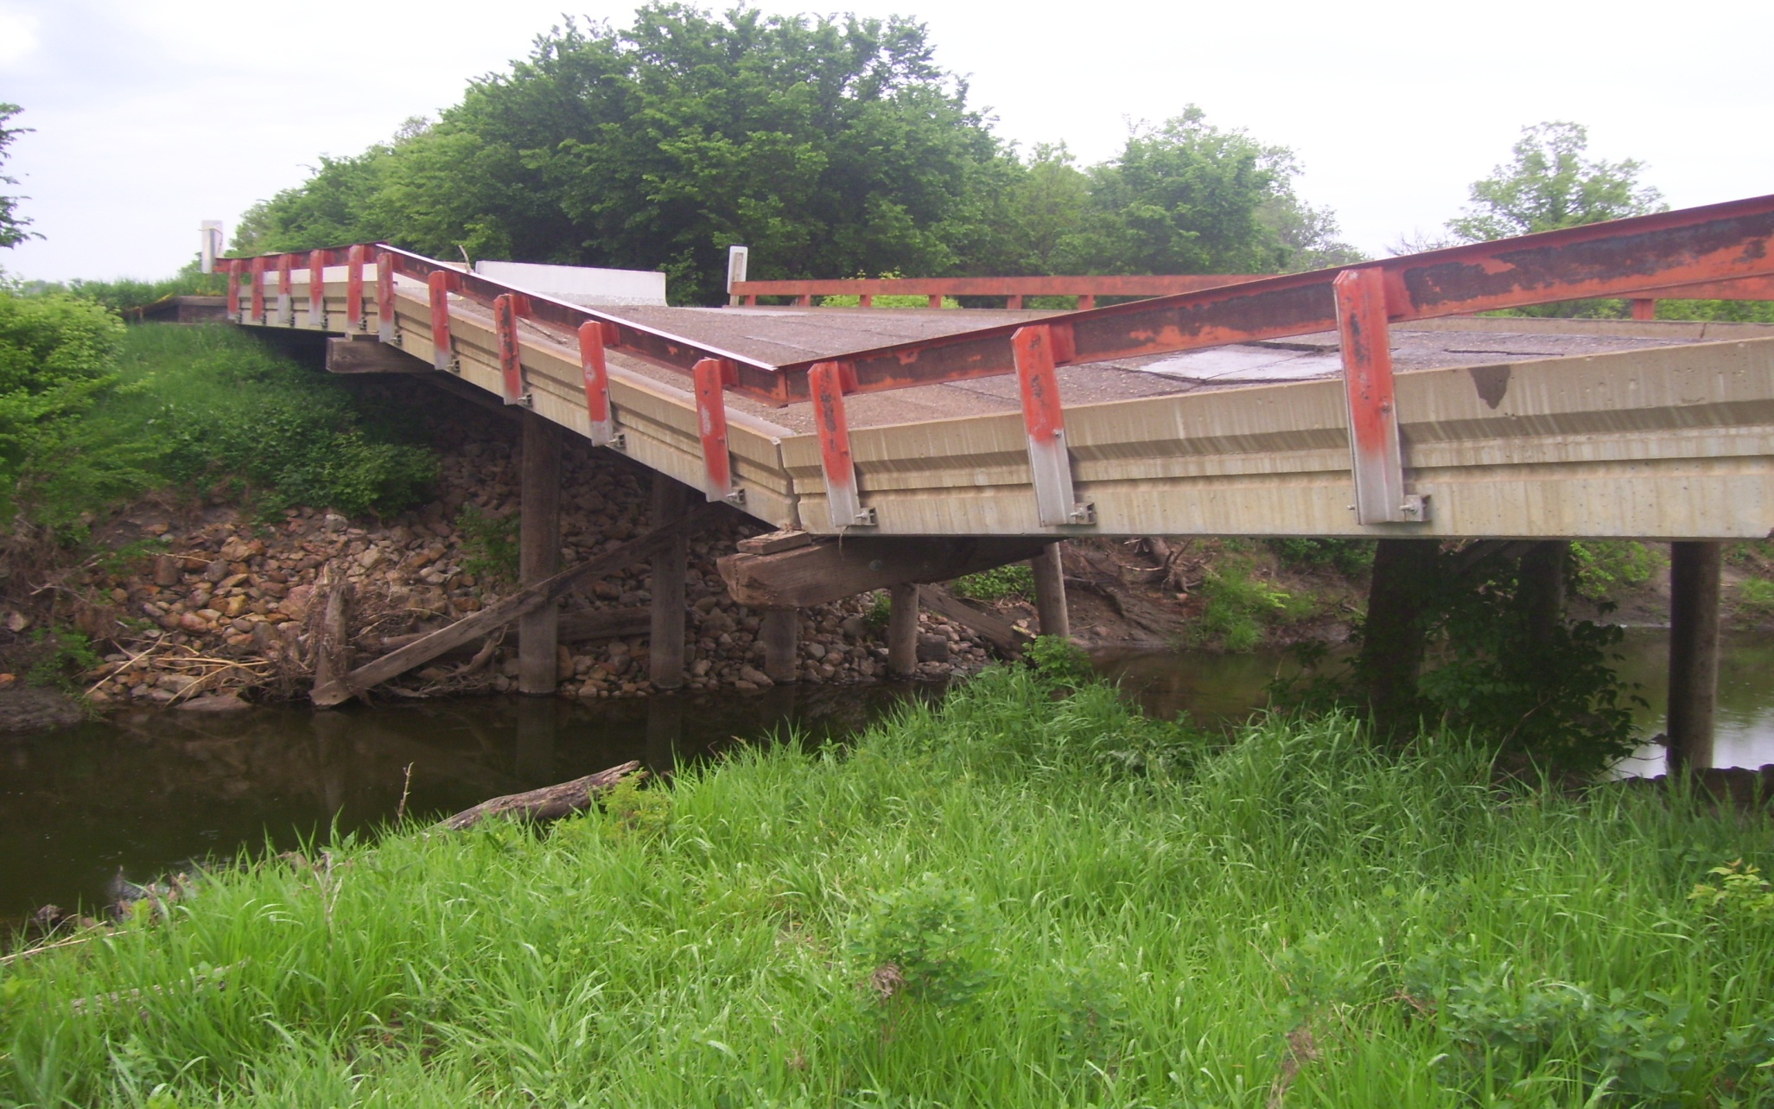
BIA A069 Oak Creek Bridge, Standing Rock Sioux Reservation.

Slide 9
Impacts to Indian country of inadequate road maintenance
Missed school days due to impassable bus routes;
Delayed transport of tribal members to emergency health and trauma centers;
Delayed response times for public safety officers (police and fire fighters) to respond to calls for help;
Increased Motor vehicle crashes and pedestrian accidents;
Increased costs for motor vehicle repairs and gas;
Longer commutes (detours);
Higher cost of goods and services due to isolation; and
Perpetuation of transportation barriers to commercial investment and job creation.
Shortened design life of roads and bridges, requiring reconstruction of facilities earlier than planned.

Slide 10
Documenting Indian country’s road maintenance needs:
As recently as 2009-2010, Indian tribes documented their unmet maintenance needs by promptly obligating and expending approximately $141.2 million in American Recovery and Reinvestment Act (ARRA) stimulus funds allocated by Interior Secretary Salazar to improve BIA System roads rated in “fair” condition and structurally deficient BIA System bridges.
The $141.2 million ARRA road maintenance investment represents over 5 ½ years of FY 2015 level appropriations for the BIA Road Maintenance Program.
ARRA Obligations: $141.2 million
Number of ARRA R/R Projects funded: 395
Percentage of ARRA projects Obligated: 99.9%
Number of ARRA contracts: 316

Slide 11
The consequences of Poorly Maintained Roads in Indian Country: Compromised Public Safety
There is no “Golden Hour” in Indian country – the first sixty minutes after a person suffers severe trauma when medical intervention can greatly increase the likelihood that the person survives the trauma and minimizes the period of the person’s post-trauma recovery.
Motor vehicle injuries are the leading cause of death for Native Americans ages 1-34, and the third leading cause of death overall for all Native Americans.
“Safety Belt Use Estimate for Native American Tribal Reservations,” NHTSA, Final Report, Oct. 2005 (DOT HS 809-921).

Slide 12
The consequences of Poorly Maintained Roads in Indian Country: Compromised Public Safety
The motor vehicle death rate for Native Americans is nearly twice as high as other races. Id.
The Billings, Aberdeen, and Navajo Areas had motor vehicle-related death rates at least three times greater than the national rates. “Atlas of Injury Mortality Among American Indian and Alaska Native Children and Youth,” Center for Disease Control, 1989-1998, Executive Summary.
American Indians have the highest rates of pedestrian injury and death per capita of any racial or ethnic group in the United States. “Pedestrian Safety in Native America,” FHWA, Sept. 2004 (FHWA-SA-04-007).
Fatal motor vehicle crashes increased 52.5% from 1975 – 2002. “Fatal Motor Vehicle Crashes on Indian Reservations 1975 – 2002,” NHTSA (Apr. 2004) DOT HS 809 727.

Slide 13
The “Four E’s”
Many Indian tribes lack the resources to establish a
comprehensive “Four E’s” traffic safety program.
Engineering (pavement, striping, rumble strips, lighting design, speed limit);
Emergency response (comprehensive system of emergency medical treatment and transport, including 911, EMS, law enforcement, firefighters, hospitals and trauma centers);
Enforcement (impaired driving, aggressive driving, speeding, lack of compliance with seat belt and child-passenger safety laws, and trucking) and regulation (traffic laws, citation, court adjudication, and sanctions); and
Education and information (driver education (“Click It or Ticket”), school bus stops and school zones, active worksite safety zones, signage, community outreach (motorist, pedestrian and bicycle safety), etc.).

Slide 14
Understanding the BIA Road Maintenance Program
According to recent testimony before the Senate Indian Affairs Committee by John Smith, Director Transportation for the Northern Arapaho and Eastern Shoshone Tribes, BIA appropriations for road maintenance/per mile equates to about 5% of what counties spend per road mile ($600/road mile versus $11,000/road mile). Wind River has the highest rate of pedestrian deaths in the country.

Slide 15
Understanding the BIA Road Maintenance Program
Yet, the BIA retains “primary responsibility, including annual funding request responsibility,” for road maintenance programs on Indian reservations. 23 U.S.C. 202(a)(8)(B).
Tribes may elect to use the greater of 25% of their TTP Program construction “tribal shares” or $500,000 for “the purpose of maintenance.” 23 U.S.C. 202(a)(8)(A). To be eligible, an Indian tribe must include “road maintenance (23 U.S.C. 202(a)(8)(A))” to their FHWA-approved Transportation Improvement Program (TIPs). A tribe’s decision to repurpose TTP funds for maintenance, however, is supplementary to, and not in lieu of the BIA Road Maintenance Program funding. 23 U.S.C. 202(a)(8)(B)
.

Slide 16
Understanding the BIA Road Maintenance Program Funding Formula
To further compound the problem, annual appropriations for the BIA Road Maintenance Program are divided 6 ways which strains available funding:
Road Maintenance and Administration;
2. Bridge Maintenance;
3. Emergency Maintenance;
4. Airstrip Maintenance;
Ferry Operation and Maintenance;
Snow and Ice Removal.

Slide 17
57% of FY ’15 ($26.46 mil.) for BIA Road Maint. Program = $15.08 mil. for routine road maintenance of BIA System routes; 19% of $26.46 mil. = $5.02 mil. for emergency maintenance needs. Thus, for every BIA Program dollar appropriated, 75 cents actually covers road maintenance needs. Salaries often are the largest component of a Road Maintenance Program budget.

Slide 18
Understanding the BIA Road Maintenance Program
Road Maintenance and Administration (57%): Grading road surfaces, cleaning ditches and culverts, filling potholes; and repairing pavement.
2. Bridge Maintenance (21%): The BIA owns approximately 770 bridges which must be inspected on a 2-year cycle to report prescribed maintenance work to address urgent safety concerns as well as routine and preventive maintenance activities to limit deterioration.
Emergency Road Maintenance (snow/ice removal) (19%): Funding covers snow and ice removal, washout and landslide repairs, and other emergencies to ensure public access to jobs, schools, health care facilities and other programs critical to Tribal members during winter emergency situations.

Slide 19
Understanding the BIA Road Maintenance Program
Airstrip Maintenance (2%): Funds all FAA-approved airstrips located on Indian reservations not maintained by other governments for snow/ice removal, grading, etc. to allow for medical evacuations and fire fighting emergency activities.
5. Ferry Operations and Maintenance (1%): BIA provides for the operation and maintenance of the ferry crossing at Lake Roosevelt providing a transportation link on the Colville Indian Reservation.

Slide 20
Twelve years ago, in 2003, the BIA estimated transportation funding needs for Indian country as follows:
$500 mil./annually for Indian Reservation Roads (IRR); Congress actually appropriates $450 mil. annually for the IRR Program under SAFETEA-LU
$120 mil./annually for BIA road and bridge maintenance; Congress appropriated only $26.46 mil. in FY 2015
$100 mil./annually for upgrading and expanding transit services and systems; Congress appropriated $30 mil. for Tribal Transit in FY 2015
$50 mil./annually for bridge rehabilitation and replacement; Congress reduced funding for the TTP Bridge Program to $9 million annually (2% takedown) under MAP-21. This represents a 35% cut from SAFETEA-LU’s $14 million funding level.

Slide 21
Understanding the BIA Road Maintenance Program
Miles of Existing BIA Roads by Region vary
Great Plains | Southern Plains | Rocky Mtn. | Alaska | Midwest | Eastern Oklahoma | Western | Pacific | Southwest | Navajo | Northwest | Eastern | Total
2037 | 277 | 2547 | 34 | 1674 | 0 | 6301 | 747 | 4753 | 5979 | 3454 | 1184 | 28987

Slide 22
Understanding the BIA Road Maintenance Program
Number of BIA System Bridges by Region Vary

Slide 23
Understanding the BIA Road Maintenance Program
Some BIA Regions receive little or no BIA Road Maintenance Program funds. Therefore, those Regions’ tribes do not have as great an incentive to support increases to the BIA Road Maintenance Program (TPA) during TIBC meetings as do other tribes.
93% of BIA Road Miles are located in 7 BIA Regions (Navajo, Western, SW, NW, Rcky Mtn, Midwest and Great Plains).

Slide 24
Understanding the BIA Road Maintenance Program Funding Formula
Although the BIA calculates and distributes Road Maintenance Program funds based on historical percentages of each tribe’s BIA System roads and bridges, regulations for the TTP Program (25 C.F.R. Part 170) expanded the class of public transportation facilities eligible for BIA Road Maintenance Program expenditures.

Slide 25
Understanding the BIA Road Maintenance Program
The following public transportation facilities are eligible for maintenance under the BIA Road Maintenance Program:
1. BIA road systems and related road appurtenances (signs, striping, guardrails, etc.), highway bridges, boardwalks, adjacent parking areas, maintenance yards, bus stations, pedestrian walkways, paths, bike and other trails, BIA and tribal post-secondary school roads and parking lots built with IRR Program funds, public access roads to airports, motorized vehicle trails.

Slide 26
Understanding the BIA Road Maintenance Program
Other Allowable uses of BIA Road Maintenance Program funds:
2. Tribal transportation facilities such as public roads, highway bridges, trails and bus stations; and
3. Non-BIA/non-Tribal transportation facilities if the tribe served by the facility determines that maintenance is required to ensure public health, safety and economy, and the tribe signs an agreement with the public authority that owns the facility. 25 C.F.R. 170.803.

Slide 27
Understanding the BIA Road Maintenance Program
Tribes also require adequate Road Maintenance Program
funds to establish Maintenance Management Systems to:
uniformly collect, process and update road inventory data;
Predict facility deterioration;
Project maintenance costs;
Track and report costs and activities accomplished;
Forecast short- and long-term budget needs;
Recommend programs and schedules for implementation within budget constraints;
Track and report unmet road maintenance needs;
Provide reports;
Determine maintenance activities per mile broken down by surface type;
Determine bridge maintenance by surface area of deck and frequency;
Calculate future needs, etc.

Slide 28
Recommendations:
Identify the BIA Road Maintenance Program as an important public safety program need for your tribe (safe roads make economic development, education, health care, and public safety services possible) discuss revisiting the funding formula when speaking to members of Congress, the BIA and the Tribal-Interior Budget Council (TIBC), and advocate for program funding of $150 million over the next few years.
Ask to speak to OMB officials to clarify that the use by tribes of “up to 25%” of their Tribal Transportation Program construction funds for road maintenance supplements, but does not replace, BIA Road Maintenance Program funds Interior obtains from Congress;
Meet with State DOT and county transportation officials to discuss the condition of public roads serving your tribe and opportunities to partner on maintenance projects or reconstruction projects using TTP funds;
Insist that your Tribal Roads Department and BIA Region Branch of Roads maintain current data re: deferred maintenance, heavy equipment needs, funding shortfalls, etc. to share with Congressional, BIA and FHWA officials annually. 142245.1

